Slide 1
BMC’s QI Hub is your resource for all things quality improvement.
Visit bucme.org/BMCQIHUB or email QIHub@bmc.org for access to professional coaching, educational tools, support, mentorship, and much more!

Slide 2
Run Charts and Understanding Variation
Leading Change Collaborative
Learning Block 3 – 12/13/2021

Slide 3
Disclosure
Natalie Sanfratello, MPH has no relevant financial relationships to disclose

Slide 4
Learning Objectives
Explain the key elements of a run chart
Discuss the advantages of tracking data over time vs pre-post data
Distinguish between common cause and special cause variation.

Slide 5
How do we know if an intervention is leading to a change?
Run charts help you to:
Learn about the system you are trying to improve at baseline
Make a judgment about whether the interventions are leading to a change
Determine if your improvement has been sustained

Slide 6
Building a Run Chart

Slide 7
Run Chart Sample

Slide 8
How to start
Obtain your baseline data!
Label your chart!
X-axis – Most likely will be time, but could be occurrences, patients, or events. Include room for future events/time. Label!
Y-axis – Create a logical scale for the y-axis based on your baseline data. The data should mostly reside in the middle of the scale to allow space to plot future data points. Label!
Plot your data points.
Calculate a median (you must have at least 10 data points to calculate the median). Place median line on your chart.
Place a goal/target line (optional)
ANNOTATE AS YOU GO!
The Health Care Data Guide (p70)
Notes:
Run Charts are a great way to start with all projects. As you start to gather more data, you can begin to transform your Run Charts into Shewhart Charts.

Slide 9
Why track data over time in QI projects?

Slide 10
Data Over Time vs Pre-Post Data
Dr. Miller is the Medical Director of a small private practice in Dorchester. He received complaints that his office was taking too long to call patients back.
He then started a QI project to reduce the delay times in patient callbacks. His office created a process map, key driver diagram and came up with key areas in the process to change.
They make the change, and then gathered to discuss their data…

Slide 11
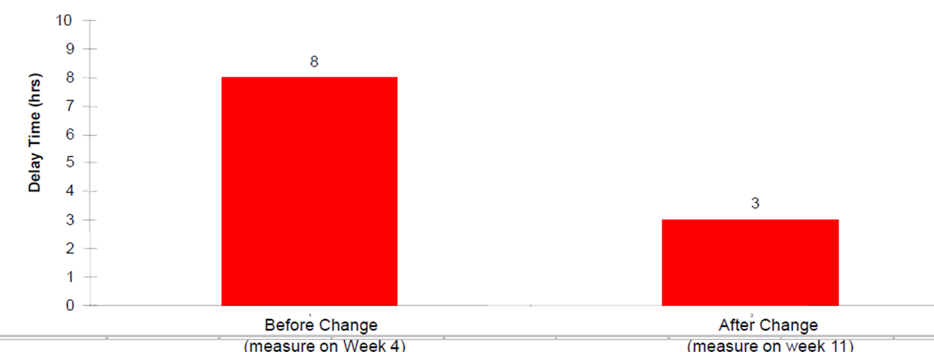
Data Over Time vs Pre-Post Data
Scenario #1: Data is taken once before and once after the change was made.
Did the change lead to improvement?
The Improvement Guide (p149)

Slide 12
Data Over Time vs Pre-Post Data
Scenario #1: Data is taken once before and once after the change was made.
Did the change lead to improvement? Yes! Wait … No, Maybe?
The Improvement Guide (p149)

Slide 13
Data Over Time vs Pre-Post Data
Scenario #2: Data is taken incrementally over time throughout the project
Did the change lead to improvement?
The Improvement Guide (p149)

Slide 14
Data Over Time vs Pre-Post Data
Scenario #2: Data is taken incrementally over time throughout the project
Did the change lead to improvement? Yes!
The Improvement Guide (p149)
Notes:
We’ll go over rules of Run Charts to know that there has been a change here. There’s been a “Shift” in the data (6 data points below – or above – the median line.

Slide 15
Data Over Time vs Pre-Post Data
What else could this data be representative of?
Why was it difficult to answer whether the change led to improvement?

Slide 16
Did the change lead to improvement?
The Improvement Guide (p150)

Slide 17
Random Variation
Did the change lead to improvement? NO!
Change did not hold
The Improvement Guide (p150)

Slide 18
Random Variation
Headed down before the change
Did the change lead to improvement? NO!
Change did not hold
The Improvement Guide (p150)

Slide 19
Random Variation
Headed down before the change
Did the change lead to improvement? NO!
Change did not hold
Improvement occurred before the change
(Week 5)
The Improvement Guide (p150)

Slide 20
Random Variation
Headed down before the change
Did the change lead to improvement? NO!
Change did not hold
Improvement occurred before the change
(Week 5)
Week 4 was not typical of the process.
The Improvement Guide (p150)

Slide 21
Why view data over time?
There will be variation due to causes unrelated to the change being tested
The effect of the change must be distinguished from these variations
Viewing the pattern of the data over time can assist in this distinction

Slide 22
Understanding Variation

Slide 23
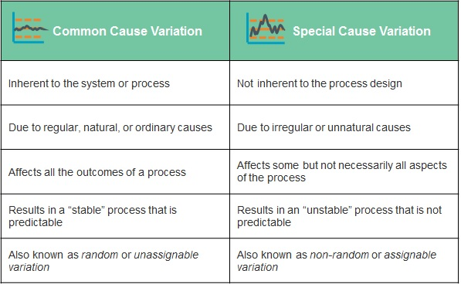
Run charts help us understand the type of variation present in our data
Data
Median
Time
Intervention
Data
Median
Time
Notes:
When it comes to processes, Shewhart and Deming divide variation into two categories: common cause and special cause.
Common Cause: The inherent variation of a process. It’s predictable within certain limits. It’s sometimes called “noise,” in acknowledgment of the randomness of the variation. An example of this: my temperature is usually between 97 – 99 degrees Fahrenheit.
**Next slide: predictable within statistical limits
Special Cause: Due to unnatural causes that are not inherent in the process. One or more data points vary in an unpredictable manner due to a cause not inherent in the process. Following the same example: I get an infection, develop a fever, and my temperature shoots up to 103 degrees Fahrenheit. My fever is a signal that the process has changed. Special cause variation can be intentional, when we’re trying to change the system– we look for a signal/trend to be able to declare victory that we have changed our process.
“When one did not plan for a special cause it will usually be undesirable. When one makes a change to improve a process, a special cause can signal that the change effort has indeed been effective. On the other hand, a process that exhibits only common cause variation may be stable and predictable, but totally unacceptable.” - Carey
“Understanding how to improve the system means understanding the points of variation in the system and discerning what you need to respond to (signal) and what you don’t need to respond to (noise).” – James slideset
Picture: IHI Open School QI104, Lesson 2: http://app.ihi.org/lms/lessonpageworkflow.aspx?CatalogGuid=6cb1c614-884b-43ef-9abd-d90849f183d4&CourseGuid=7ef37a50-827f-477b-b603-9b4eef065fe6&LessonGuid=af3f7096-e52d-405d-852b-340decff4dfe

Slide 24
4 Rules of Nonrandom Signals of Change
Rule #1 – Shift
6 or more consecutive points either all above or all below the median
A point that falls on the median doesn’t add to or break a shift
Perla et al, 2011
Notes:
Ignore the point that falls on the median and keep counting.

Slide 25
4 Rules of Nonrandom Signals of Change
Rule #2 – Trend
5 or more consecutive points all going up or all going down
Consecutive points being the same do not make or break a trend
Perla et al, 2011
Notes:
Ignore the like values and keep counting

Slide 26
4 Rules of Nonrandom Signals of Change
Rule #3 – Runs
Too few or too many runs (a series of points on one side of the median line) crossing the Median line
If the data line did not cross the median, a new run has not begun
Perla et al, 2011

Slide 27
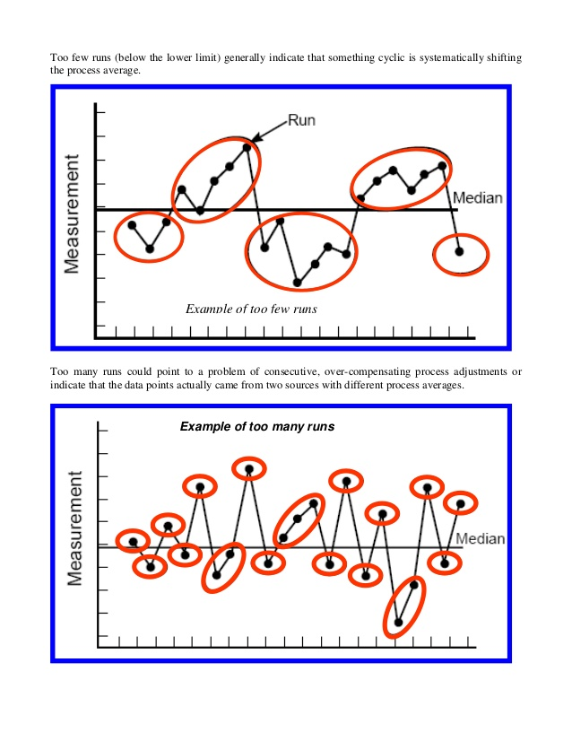
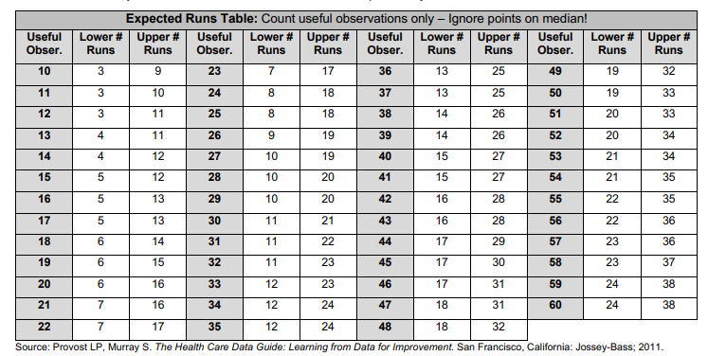
4 Rules of Nonrandom Signals of Change – 3 ctd.
Nat Evans on Slideshare - Community Engagement at Process Excellence Network (PEX Network - a division of IQPC): https://www.slideshare.net/PEXNetwork_team/run-charts-14786427
Notes:
The criterion for the number of runs for “k” data points are based the distribution of runs in random samples of continuous data.
Lower limit = k_{bar} – t _{k-1, .05} S_{k}
Upper limit = k_{bar} + t _{k-1, .05} S_{k}
The parameters of this are:
k_{bar} = Mean = (k+2)/2
S_{k} = Standard deviation = √ (k/2 * (k/2-1) / (k-1))
t = tabled t statistic

Slide 28
4 Rules of Nonrandom Signals of Change – 3 ctd.
Too many or too few runs can indicate the data needs to be stratified into sub-groups; you may be observing differences between a night shift and a day shift, for example.
Stratifying may also help to identify disparities based on certain demographic factors.
Graphing the data on two separate run charts will help you understand each sub-group better.

Slide 29
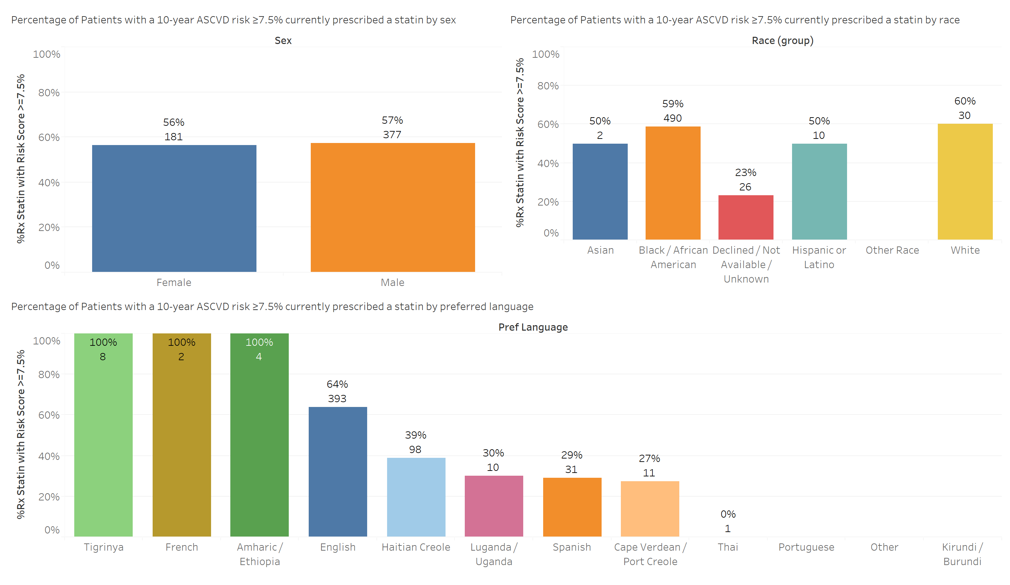
When we disaggregate the data, we may become more knowledgeable about what PDSAs may make a difference
We could also make our aim statement more specific!

Slide 30
4 Rules of Nonrandom Signals of Change
Rule #4 – Astronomical Point
An obviously and blatantly different value.
Anyone studying the chart would agree that it is highly unusual.
Rocco et al, 2011

Slide 31
Understanding Variation
Since we are implementing changes in a real-world setting, there will be variation in the measure of the product or process due to causes unrelated to the change being tested
The effect of the change must be distinguished from these unrelated variations

Slide 32
Understanding Variation
Common Cause Variations
“Causes that are inherent in the system (process or product) over time, affecting everyone working in the system, and affecting all outcomes of the system”
A system that ONLY common cause variations affect the outcome is called a stable system
Special Cause Variations
The Healthcare Data Guide, p108

Slide 33
Understanding Variation
Common Cause Variations
Special Cause Variations
“Causes that are not part of the system (process or product) all the time or do not affect everyone, but arise because of specific circumstances.”
A system that contains both common and special cause variations that affect the outcomes is called an unstable system.
The Healthcare Data Guide, p108

Slide 34
Common mistakes made with variations
Common Cause Variations
Treating common cause variation as if it was a special cause variation.
Will cause one to adjust the system when the only way to improve the system is by fundamentally changing it.
Special Cause Variations
Accepting special cause variation as if it was a common cause variation.
Will cause one to miss an opportunity to fix a problem.
The Healthcare Data Guide, p108

Slide 35
How to Respond to Variation
Type of Variation in Your Data | Management Strategy
Special Cause Variation | Early Stage of Project: Investigate origins of special cause. If the special cause is negative, try to eliminate it. If the special cause is positive, we should try to learn from it and possibly replicate it. **Addressing special causes = creating a more stable, predictable system.** | Later Stage of Project: The way improvement is manifested. We create a source of special cause that we control (our interventions)
Common Cause Variation, & Functioning at Unacceptable Level | Reduce the amount of variation, and move the process average in the desired direction (change the underlying process). Testing changes in a stable system = more certainty that improvement is due to your intervention and not something else.
Notes:
Chart above culled from a few sources – IHI oresent
FitBit Data connection – I bought a new wristband. I do have an aim of 15,000 steps a day, but I have not done any PDSAs to improve.

Slide 36
How to Respond to Variation (Control Chart)
Current State
Unstable process
Special cause present
Process average is high
Action Required
Identify and eliminate bad special causes
Identify and build in good special causes
Source: Handbook for Improvement—A Reference Guide for Tools and Concepts Healthcare Management Directories, Inc. 2002
Notes:
36

Slide 37
How to Respond to Variation (Control Chart)
Current State
Stable process
Common cause variation has been reduced
Process average is too high
Action Required
Take action to move the average of the process down – create a special cause variation within the system to fundamentally change it
Source: Handbook for Improvement—A Reference Guide for Tools and Concepts Healthcare Management Directories, Inc. 2002
Notes:
37

Slide 38
Questions/Comments?

