Slide 1
BMC’s QI Hub is your resource for all things quality improvement.
Visit bucme.org/BMCQIHUB or email QIHub@bmc.org for access to professional coaching, educational tools, support, mentorship, and much more!

Slide 2
Lisa Caruso, MD

Slide 3
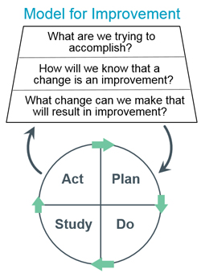
Your Fundamental Improvement Framework
What are you trying to achieve?
Have clear aims and objectives
How will you know that change is an improvement?
How will you measure processes and outcomes
What changes can you make that will result in an improvement?
What have others done? What hunches do you have? What can you learn as you go along?
Nolan et al
Building Knowledge
Notes:
The first part is the thinking part. As it says, it makes us think about what we want to do. Is there a need to change? The three fundamental questions for improvement (Nolan et al) make up this part of the methodology.
Question one asks the user to define clear aims and objectives that are crucial to successful change. If you don’t know what you want to achieve, how can you make the appropriate changes?
The second Nolan question “How will we know that change is an improvement?” focuses on the importance of measurement. If there is no clear baseline of how things are before the change has been made, how is it possible to identify whether the changes has made things better or worse? “If you can’t measure it, you can’t improve it” – Don Berwick
The third question may require a little research into what others have done. What is the point of reinventing the wheel? If changes have been made to similar systems, these ideas can be adapted and tested in your own area. What do you think might work? What changes do the team think may be effective? Gathering and recording the above information takes the user onto the doing part of the methodology, the PDSA cycle.

Slide 4
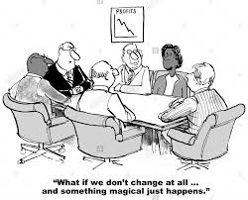

Slide 5
PDSA Session Objectives
Identify the key components of Plan-Do-Study-Act methodology
Discuss how theory and prediction help learning
Describe the strengths associated with repetitive PDSA cycles
Recognize that time series data (run/control charts) are the gold standard for establishing the degree of belief in an intervention
Understand that failure is an important source of learning in PDSA
Use a planning tool that can be used for designing and tracking the impact of PDSA tests

Slide 6
Essential Improvement Questions
What are we trying to accomplish?
Project Aim
How will we know a change is an improvement?
Measurement Strategy
What change can we make that will result in an improvement?
Change Strategies
ACT
PLAN
PDSA cycles help us choose which change strategies to implement to achieve our aim.
STUDY
DO
Langley et al., The Improvement Guide, 2009

Slide 7
Life’s PDSAs

Slide 8
PDSA TESTS ARE WHERE YOU
LEARN whether the change will result in an improvement
SEE the amount of improvement possible
LEARN how to adapt the change to different environments
UNDERSTAND the costs and impact of change
REDUCE resistance and BUILD stakeholder buy in

Slide 9
PLAN
ACT
PLAN
Elements to Consider
STUDY
DO
1
2
3
Data Collection
Hypothesis
Logistics
Develop a Question
Form a Prediction
WHO
WHAT
Need data to
answer question
WHEN
WHERE
Case Study: Increase Completion of Depression Screening Tool
Clinic wants to increase completion of depression screening tool during annual physical exam from 30% to 85% by January 2020
Current system tool given to patients in waiting room by front desk staff and asked to return to desk
Question: Will administration and collection of the depression screening tool by MAs during rooming process increase the number of depression screening tools completed ?
Prediction: % of actual depression screening tools completed by patients at time of annual PE will increase to ≥ 85% without negatively impacting patient flow

Slide 10
DO
ACT
PLAN
Perform Your Test and Collect Data
STUDY
DO
1
2
Quantitative
Qualitative
Stakeholder Reactions/Observations
Keep it simple!
Case Study: Increase Completion of Depression Screening Tool
Front line staff instructed to no longer give out depression screening tool at time of check in
MA introduced and collected the depression screening tool in the exam room prior to MD visit
Number of depression screening tools completed at time of annual exam tracked
Time spent by patient in room prior to seeing provider tracked over time before and after intervention roll-out
Daily huddles used to check in with MAs and Providers on new process

Slide 11
STUDY
ACT
PLAN
Review Outcome of Test
STUDY
DO
Compare Predictions to Actual Results
Prediction
This is where learning happens!
Results
Did your prediction come true? No ‘failure’, only learning!
Did your test run according to plan? How can you tell?
Case Study: Completion Depression Screening Tool
Completion of Depression Screening Tool increased to 60% during test period, less than predicted
Patient comfort in completing screening tool moved from uncomfortable (waiting room) to
comfortable(exam room) except in patients with health literacy issues who handed tool back to
MA and did not complete the screening
Time spent by patients in exam room prior to seeing provider did not increase

Slide 12
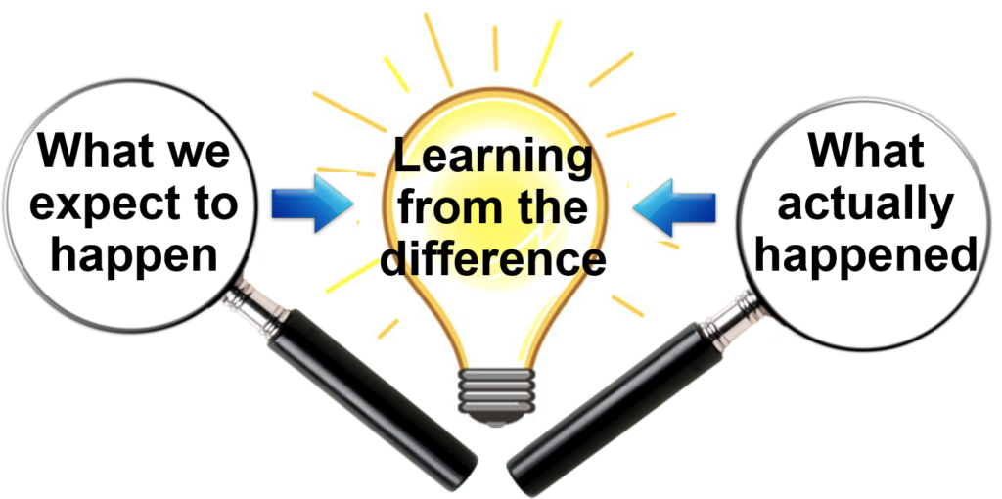
“I didn’t fail a thousand times. I found a thousand ways not to make a light bulb” ~Thomas Edison

Slide 13
ACT
PLAN
ACT
STUDY
DO
Modify Plan Based on Learning
Adopt
Only after well
tested
?
Adapt
?
?
Abandon
Case Study: Increase Completion Depression Screening Tool
MA staff to query patient if needs assistance in answering questions on tool
Operations Manager to obtain copies of test in top 5 languages or clinic
When specific language not available MA to use interpreter phone

Slide 14
Creating Belief That It Was the Intervention That Created Result
Images: Radiographics. 2012 Nov-Dec;32(7):2113-26.

Slide 15
Time Series Data RUN CHARTS Validates Belief Effectiveness of Change

Slide 16
Repetitive Cycles PDSA’S Strength
System testing
ACT
PLAN
Sustainability
Widely Tested /
Degree of Belief
Created
STUDY
DO
ACT
PLAN
STUDY
DO
Testing and
refining ideas
ACT
PLAN
STUDY
DO
ACT
PLAN
Wide scale
test of change
STUDY
DO
Accumulating information, data and knowledge
ACT
PLAN
STUDY
DO
Testing new
conditions
ACT
PLAN
STUDY
DO
Fine Tuning
Follow up tests
Theories,
Hunchies
Best practices
Very small scale test of change

Slide 17
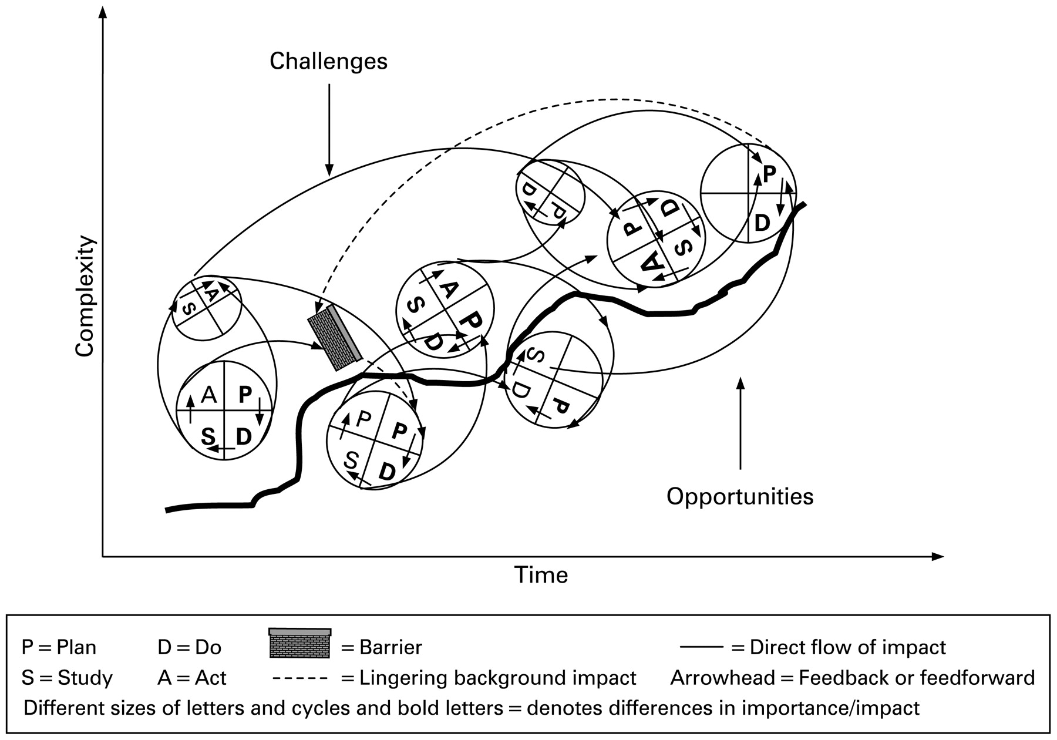
Reality
PDSA Cycles are all about LEARNING and that’s never a straight line
Tomolo A M et al. Qual Saf Health Care 2009;18:217-224
Notes:
No this is what truly will look like having led many PDSA cycles in many projects. LEARNIN is never in a straight line

Slide 18
Notes:
Setting the context
You’ll see we’ve given you a PDSA Worksheet for your projects that we think you’ll find helpful
I thought it might be useful to show you how we might have completed this for a dummy project in Primary Care . The plot and characters are all fictional
This is about a Depression Screening Tool given to patients by front desk staff at time of annual physical exam to be completed by patients in the waiting room before being taken back to exam room . Completion rate for this tool
was only 30% so patient survey done trying to capture what could be done to improve completion rates

Slide 19
Key Takeaways –Your PDSA Checklist
Make your idea to test easier to do than what it replaces
Engage leadership at the start
Test with volunteers or “friendly audience” first
Write down the questions you want to answer thru testing and predict what you’ll find pre-test
Scale down size of test .Think of a “cycle of 1” for that initial test of change, such as 1 unit , 1 billing cycle
More cycles at a smaller scale faster pace are far better than fewer, bigger , slower cycles
Collect only enough data during each test to assess your measures and answer your questions
Plan multiple cycles to test and shape your change for your environment
LEARN, LEARN , LEARN
Notes:
I’ve always liked Key Take Aways as they remind me of the mistakes I shouldn’t make . Think of this as your PDSA Checklist

Slide 20
Let’s Play!
Team Prep:
Designate:
Leader
Spinner,
Timekeeper
Recorder
Aim: Spin a US coin for the longest amount of time
Measure: Spin time
Changes: Up to you!
PDSA cycles: Try for 15 within 15 minutes
Materials:
US coins - quarter, dime, nickel, penny
PDSA tracker and Run Chart template
Timer (e.g., on Smartphone)
Spin = Total time from start to motionless

Slide 21
Coin Spin Instructions
Operational definition!
Spin time = Start of spin until coin is completely motionless on surface in seconds
Run as many cycles as possible – aim for about 15
Use PDSA tracker to help design, test, assess, and document each cycle
Use run chart to collect and plot data
We will call time out at 15 minutes and ask you to create a your run chart, and reflect on where your changes occurred on that run chart
What does your chart show?
Source: IHI Improvement Coach Professional Development Program. Fall 2017

Slide 22
IHI PDSA Coin Spinning Game

Slide 23
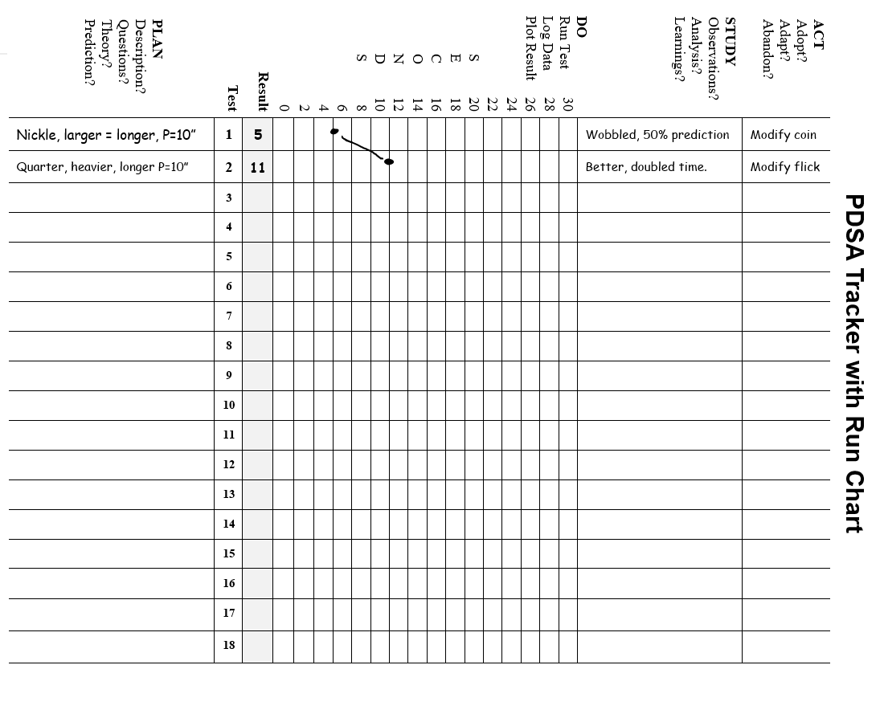
Source: Phyllis M. Virgil
Notes:
Form Source: Phyllis M. Virgil, June 2018

Slide 24
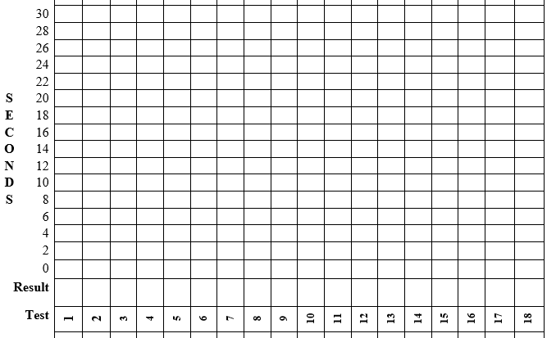
Analyze your results on a run chart
Median = (16+1)/2 = 8.5 which means it lies between the 8 and 9th points sequenced from highest to lowest. This makes the median lie at 16 seconds.
Source: Phyllis M. Virgil
Notes:
Source: Phyllis M. Virgil, July 2017

Slide 25
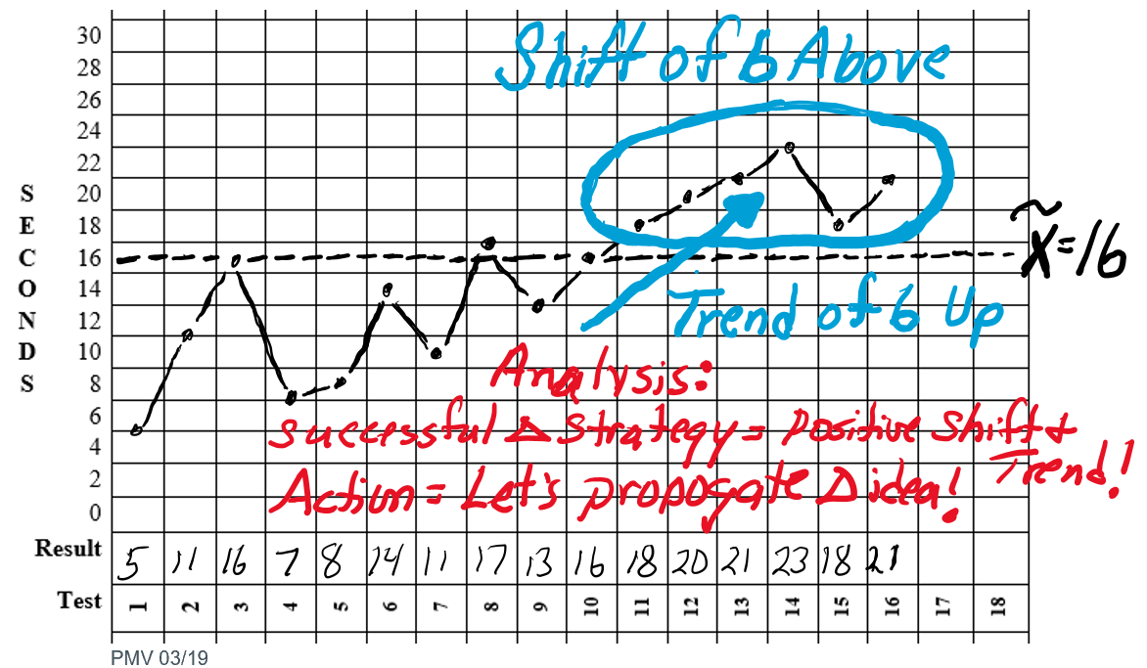
Assess and Reflect
Any surprises?
What did you learn about
Testing?
Data collection & measurement?
Variation?
Creativity?
Teamwork?
Yes PDSA is messy but so rewarding
Source: IHI Improvement Coach Professional Development Program. Fall 2017
Notes:
Find the best time and best score in the room. Ask the table what their theory was, what did they test to get to their time, and what they learned through their testing – what surprised them, etc. This is an example of best practice.
Of the longer ones, ask about the variables: what were the different variables or theories people were testing? Make notes or points as people discuss the variables.
Ask others to add on the process piece:
How did they test?
Did they track data?
How did they learn as they went?

Slide 26
Assignment for Working Session
On Planning Sheet complete AIM and PLAN Sections with your Team

